Slide 1
Library Checkout System
BY ANNA GUZ

Slide 2
Outline
1. Use Case Diagram
2. Class Diagram
3.Add copy sequence diagram
4.checkout sequence diagram
5. Validation rules
6. extra credit
7. Sci knowledge

Slide 3
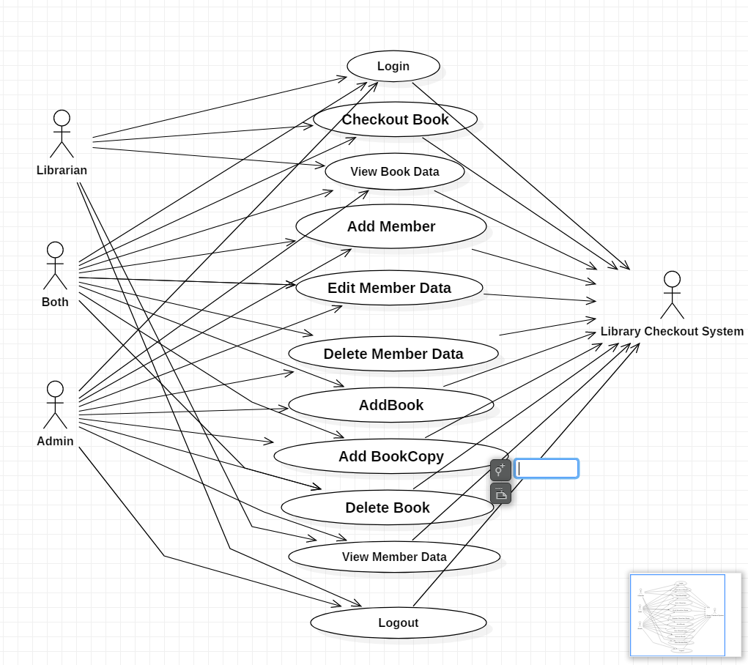
Use Case Diagram

Slide 4
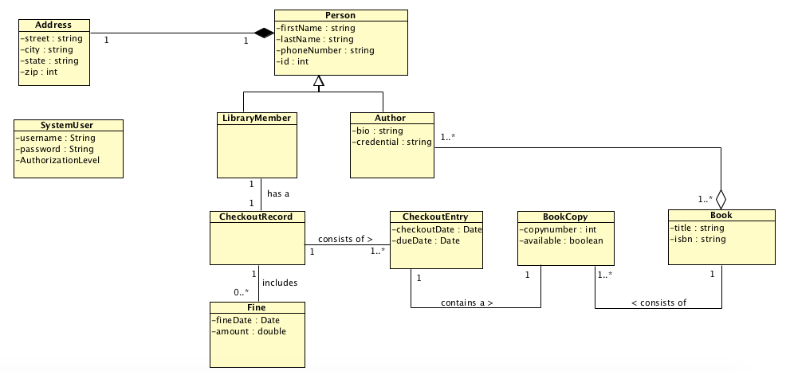
Class Diagram

Slide 5
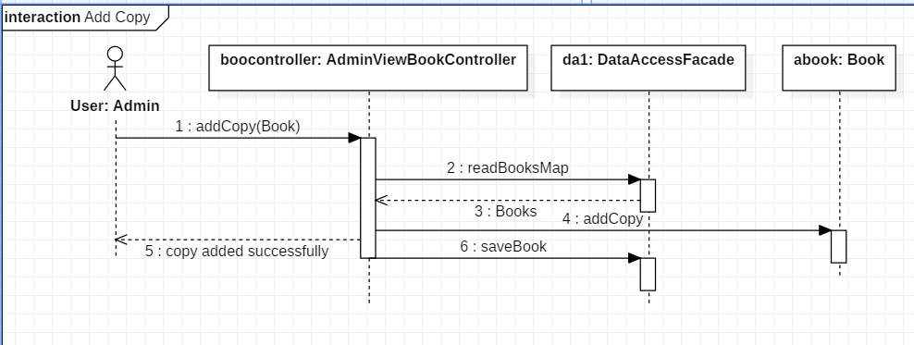
Add Copy sequence diagram

Slide 6
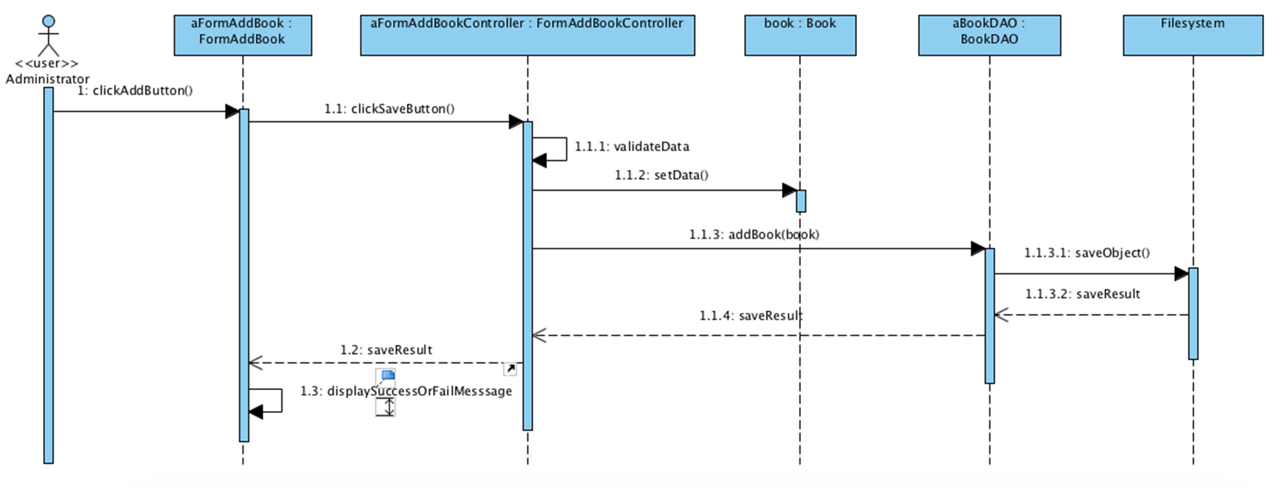
Checkout sequence diagram

Slide 7
Validation rules used
Login Window:
The user can not leave password or username empty (the system will show alert message)
The username and password entered must much
For the other windows we used empty field validation where the system checks if an input text field is left blank or not.

